Slide 1
Intramural Supervisor
Training, Notes, & Information

Slide 2
Get your cell phones out!
ISU Police (Dept. of Public Safety):
515-294-4428
Nathan’s Cell:
515-451-1911
Send me a text with your name in the message

Slide 3
COVID POLICY
IF YOU ARE NOT FEELING WELL OR HAVE SYMPTOMS, DO NOT COME TO WORK!
Communication is critical
COVID pay for student employees

Slide 4
COVID POLICY
Exposure: within 6 feet of a person who tested positive for more than 15 minutes (with our without a face covering)

Slide 5
COVID POLICY – Positive Test
Student will need to be removed from the schedule.
Student can return to work when the following conditions are met:
Positive individual can discontinue self-isolation once these 3 things occur:
No fever for at least 72 hours (that is 3 full days of no fever without the use of medicine that reduces fevers).
Other symptoms have improved. For example, when cough or shortness of breath have improve
At least 10 days have passed since symptoms first appeared.
Asymptomatic individuals with a positive test need to self-isolate until 10 days have passed since a positive test.

Slide 6
COVID POLICY – Seeking a Test
Once a student has reached out to notify that they are seeking a test, or waiting for results:
Student must be removed from schedule while awaiting test/results
Ask the student whether they are seeking the test because they are A.) experiencing symptoms B.) have been exposed to someone who is positive C.) concerned, but do not believe they have been exposed:
A.) experiencing symptoms:
Negative: can return to work
B.) have been exposed to someone who is positive
Negative: must quarantine for 14 days
C.) concerned, but do not believe they have been exposed
Negative: can return to work

Slide 7
Additional Guidance for Students Living with Someone who is Positive:
If you live with others who are in quarantine from being in contact with a positive case, but you yourself have not been in contact with a positive case, you each need to stay in your own specific areas as much as possible and avoid sharing kitchens and bathrooms, if available.
If you live with someone that is in isolation due to a positive test, you may be asked by the ISU Public Health Team to quarantine based on your level of contact with that individual.
It is possible to live with someone that is positive and not also contact the virus, practice good hygiene and avoid shared spaces as much as possible.

Slide 8
COVID POLICY
(Subject to change)
INSIDE = Masks for everyone all the time (staff & players)
OUTSIDE – Masks strongly recommended
If you are engaging someone, your mask should be on
Employees signing participants in should have a mask on
Umpires/Referees – if physical distancing is possible, mask is optional
All employees should bring their masks and have them on upon arrival/check-in.

Slide 9
COVID POLICY
Hand sanitizer
Sanitizing spray
Specific policies for each sport

Slide 10
Intramural Student Employee Purpose
We facilitate FUN and ensure sports are played fairly.

Slide 11
NOTICE
You will not supervise every shift
You will still be expected to referee
There will be schedules where you are not scheduled to supervise any shifts
“I can pick up a supervisor shift only” – NO
If supervisors begin dropping referee shifts, I will convert your remaining supervisor shifts into referee shifts
Note: you make the same amount of pay regardless

Slide 12
Am I BETTER Than You Today?
Lead Supervisor
Supervisor
Referee
WORK TOGETHER, we are all on the same team!

Slide 13
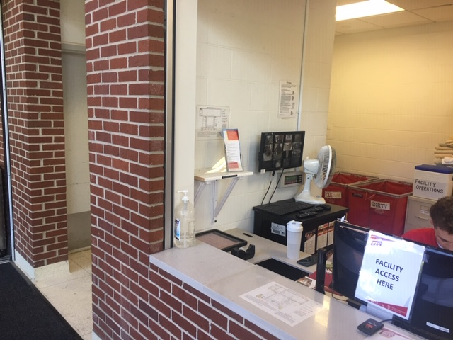
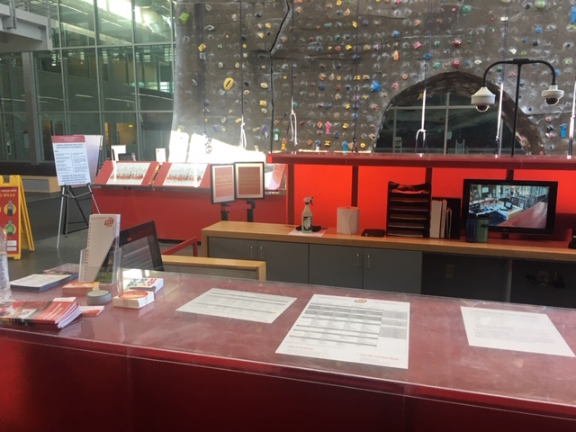
Picking up Clipboards
LEAD supervisor’s responsibility
Clipboards for events in State Gym will be at the front desk (basketball, volleyball, etc)
ALL other locations or outdoor activities will be at the Beyer desk
Beyer Pick-Up/Drop-off
State Gym Pick-Up/Drop-off

Slide 14
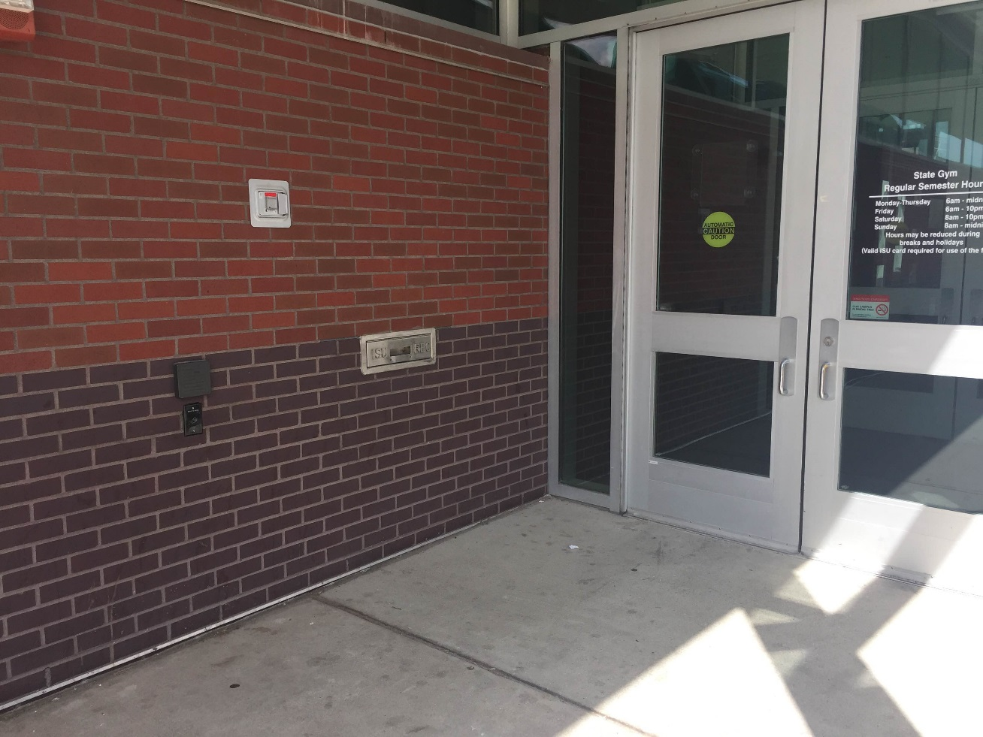
Returning Clipboards
Clipboards MUST be returned the night of the event (NOT the next morning sometime)
Clipboard return areas:
State Gym Dropbox
State Gym front desk (Only for State Gym activities)
Beyer front desk
Facilities close at 10pm (use the dropbox)

Slide 15
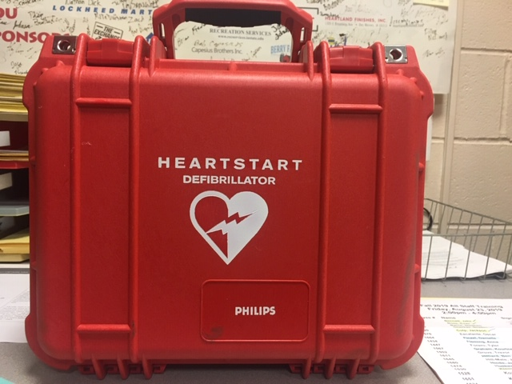
Portable AED’s
Used at all outdoor games
Will be kept on site when weather temperatures allow

Slide 16
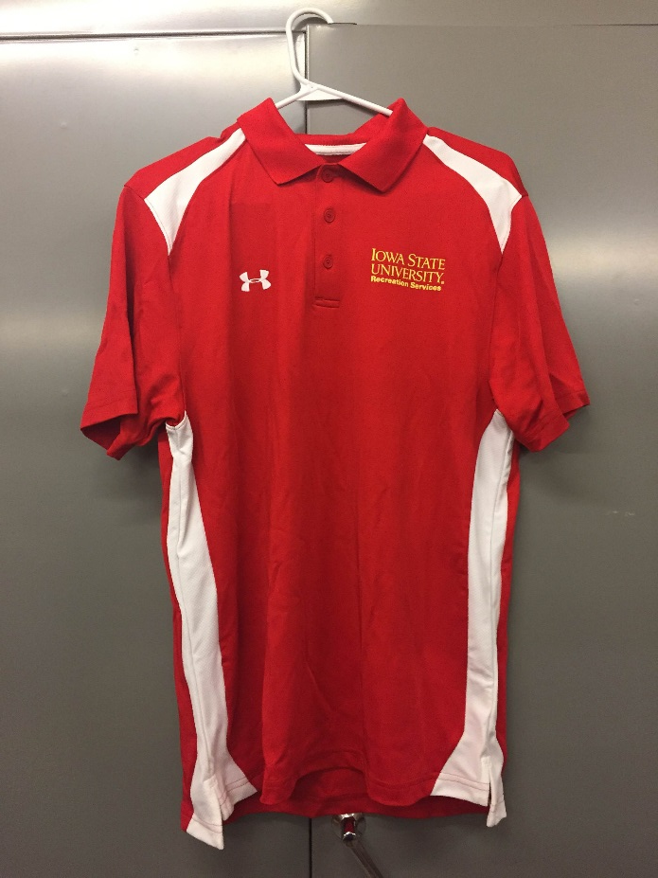
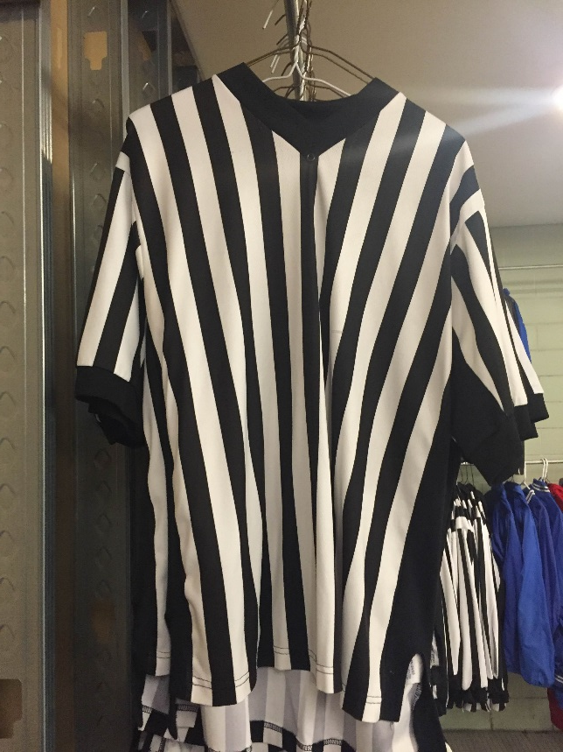
Employee Attire & Equipment
Supervisors:
Must wear IM supervisor shirt
Always carry a radio
Always have a medical kit
Always have your ipad
Referees:
Must wear ref shirt
Do NOT take shirts home.
Do NOT wear shirts in public

Slide 17
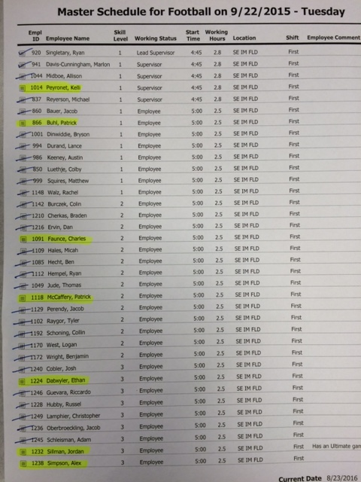
Sign In Employees
Each person signs their name & ID number
Check their name off on the list of employees
Workday clock in/out
1 option
Use phone with Workday App
Make a note on sign-in sheet that their hours need to be added manually
CIRCLE names who did not show up for their scheduled shift

Slide 18
Playing While Working
People who play will have a note next to their name on the list of employees working that night.
If someone doesn’t have a note next to their name and plays, you need to make a note on the sheet or shift report.

Slide 19
Assign Officials to Fields/Courts
Employees have “skill numbers”
Spread out officials evenly via skill/experience level
The first person you assign to a field/court, make them start gathering the necessary equipment to bring out
Another supervisor should be in charge of handing out equipment
Each hour, make sure to have the proper number of refs on each field/court
Use your radios to communicate shortages or extras
If you have extras, ask others if they need help with coverage
No fields should ever have 4 referees on one field and only 2 on another

Slide 20
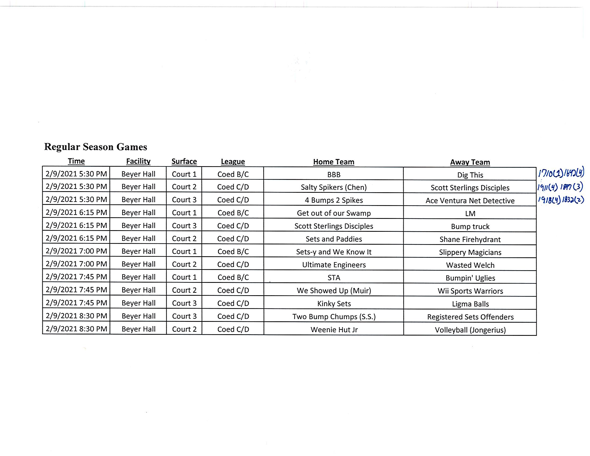
Assign Officials to Fields/Courts

Slide 21
Supervisor Equipment
Every supervisor should be carrying:
Med kit
ipad (fill out injury reports; also keep track of weather)
Walkie talkie
One supervisor will carry the AED
(Optional bucket)
No supervisors should be in the hut once games begin

Slide 22
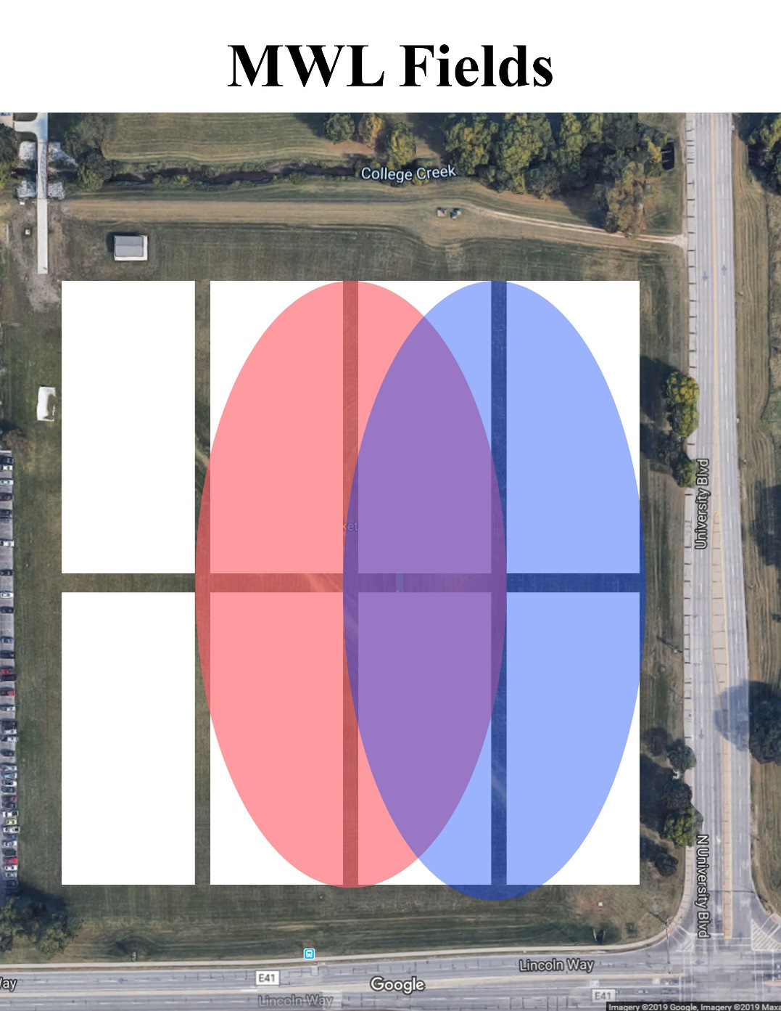
Supervisor Areas
Each supervisor will have an assigned area to cover for their shift. Stay in your area!

Slide 23
End of Night/Shift
Pile up jerseys into bags (Separate of flag belts)
Do NOT re-hang shirts that were used
Make sure all equipment is returned and put away PROPERLY
Make sure all games & employees are finished
Charge your ipad in the proper location
Turn lights off
Make sure door is locked when you leave
RETURN CLIPBOARD to BEYER/DROPBOX

Slide 24
Your Participation in Intramural Activities
We highly encourage you to participate in any sports you want
When you are playing, there will NOT be any problems from you or your team regarding sportsmanship
Our staff will NOT engage in berating your colleagues
Reports of this will be the easiest way for you to lose your position as supervisor and potentially IM employment
Cheating, sandbagging, using ineligible players will not be tolerated by our staff

Slide 25
Homework Policy
Do NOT bring your homework

Slide 26
Communication w/ Participants
You are there to be helpful and be a conflict/problem solver when issues arise
NEVER cuss towards or about any participants
Keep calm. Refer them to me if they have issues. Call DPS if necessary
Giving information to participants….

Slide 27
Unsportsmanlike Behavior (Participant/Spectators)
Depends on severity
Ask them to leave the facility
Call DPS if they won’t leave
Important to keep CALM
Do not cuss at them
If possible, give them an explanation
If they don’t like it and problems persist, follow steps above

Slide 28
Sub Reporting Policy
If the shift is a supervisor shift, you MUST get a supervisor to cover it.
If you have a sub work your shift, YOU are responsible for reporting who is subbing for you.
Fill out the form online
If you do not fill out the sub form and neither of you show up, YOU will be held accountable for missing the shift

Slide 29
Supervisor Requirements
All supervisors MUST
Take Blood Borne Pathogen & Fire Safety training
CPR/AED
EAP
Customer Service
Attend requires meetings
All staff trainings
Supervisor trainings

Slide 30
Injuries/Medical Issues
You are NOT a licensed medical care provider
Your assistance does not go much farther than providing ice packs, band-aids, gauze, etc.
If the injury requires more than these simple tasks, emergency personnel should be called immediately
NEVER assist in “popping a shoulder back into place” or anything of that nature. That is NOT your job nor in the scope of your training

Slide 31
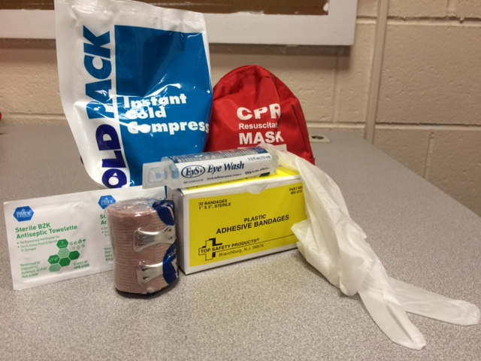
Med Kit Items
CPR Protective Mask
Bandages
Cold Packs
Cleansing Wipes
Dressing Pads
Eye Wash
Disposable Gloves
Scissors

Slide 32
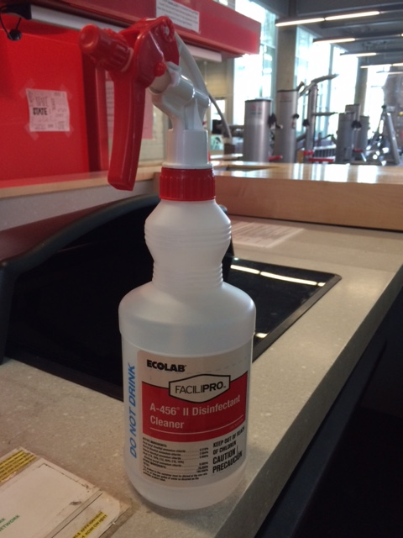
Blood Spills
Wear gloves
Spray disinfectant
Wipe up
Throw anything you used in the disposable container

Slide 33
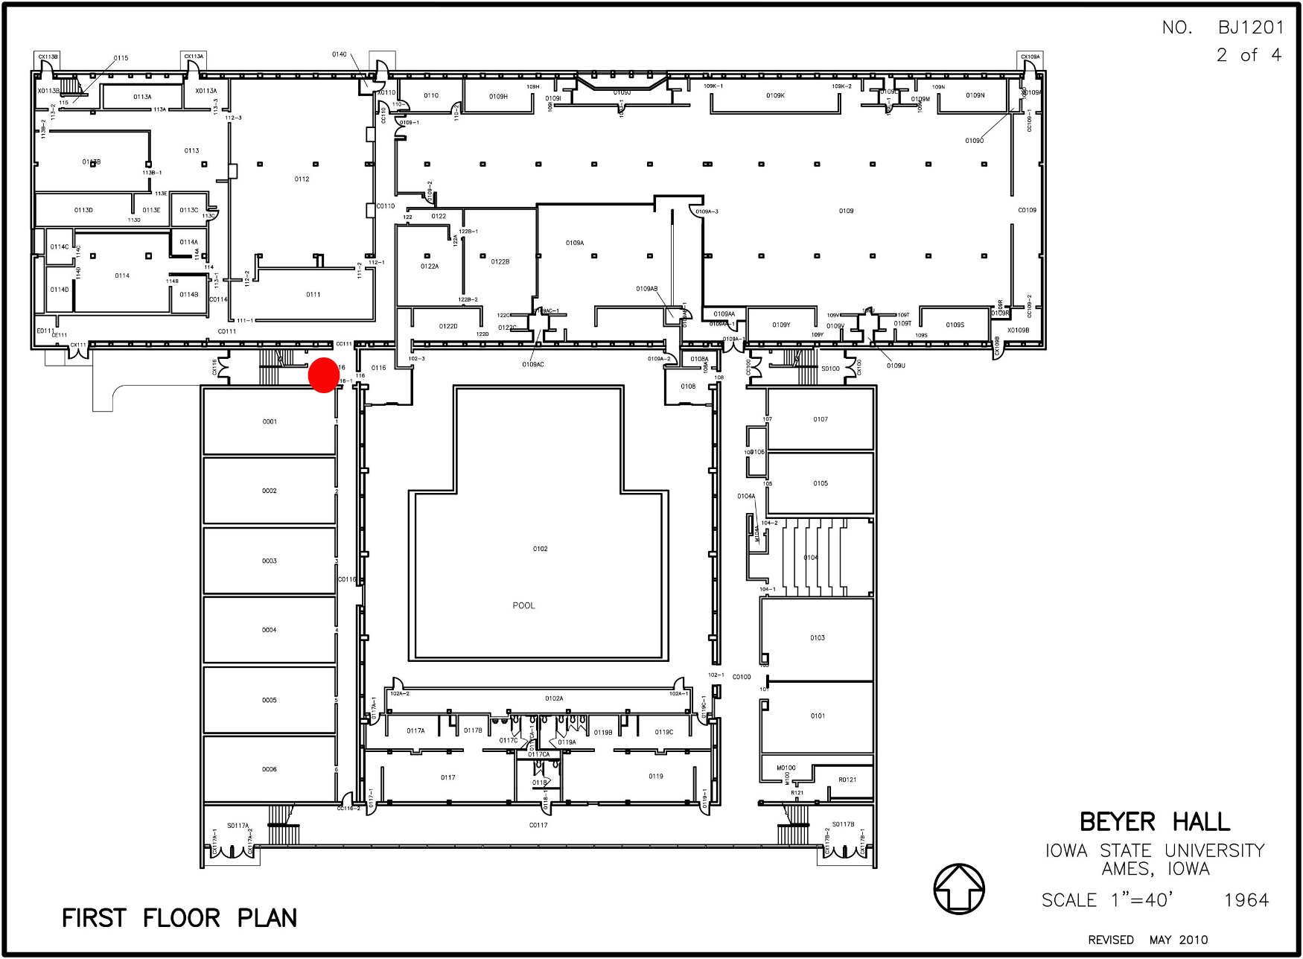
AED Locations – Beyer Hall

Slide 34
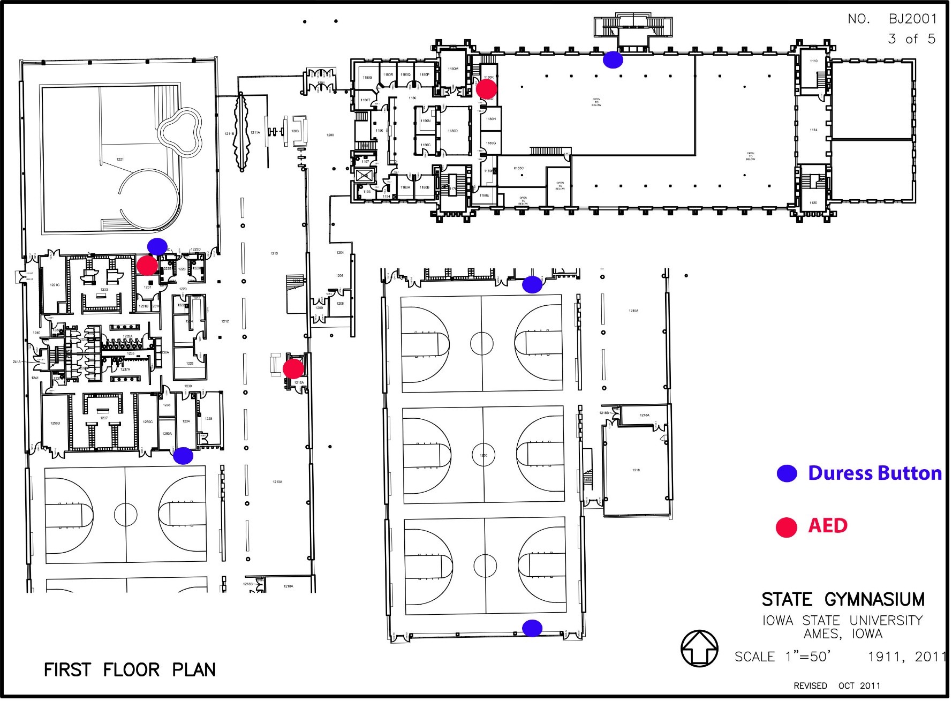
AED Locations – State Gym

Slide 35
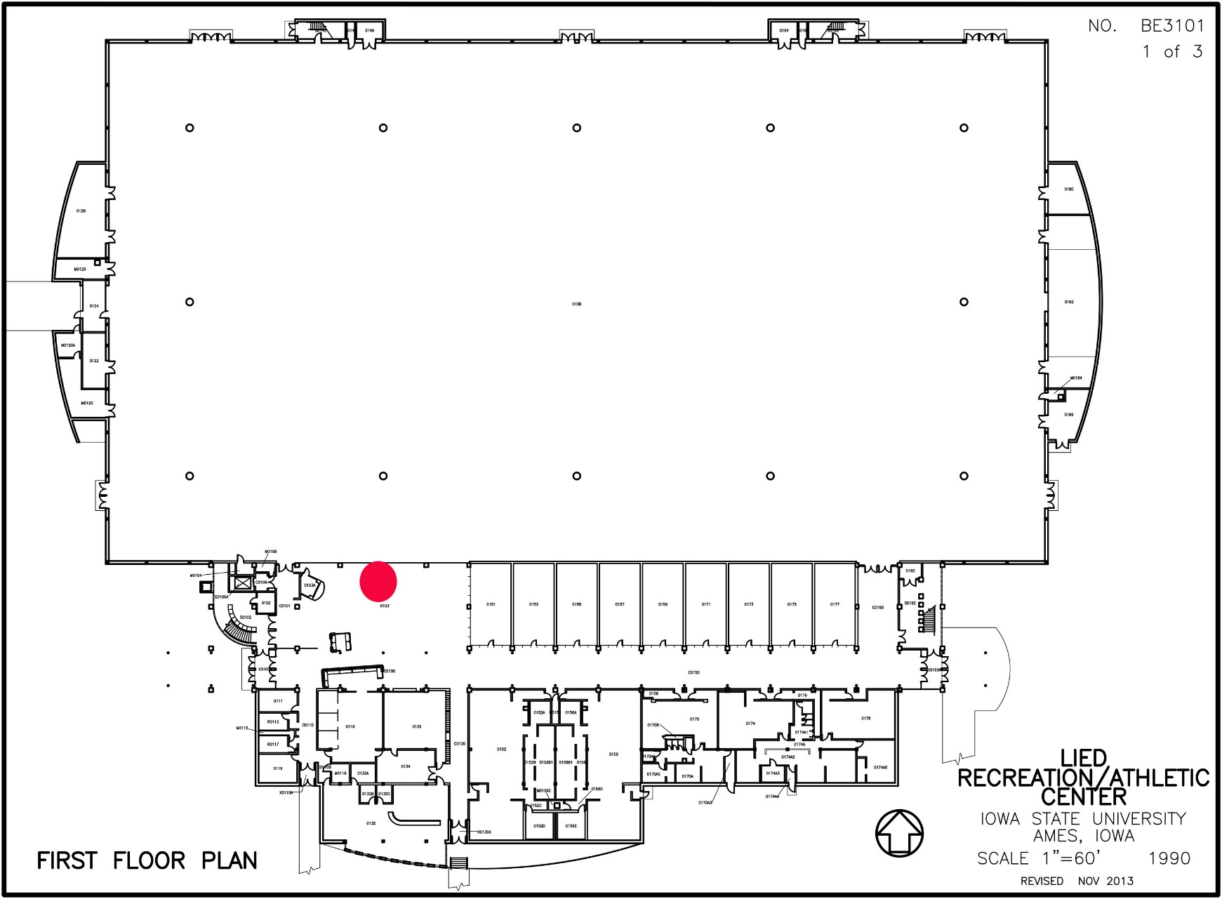
AED Locations - Lied

Slide 36
ISU ID Card Policy
Participants MUST have some form of photo ID
ISU ID card preferred
Driver’s license OK
Any indoor activity they will need ISU ID card to enter the facility (so they should have their card to check-in as well)
No ID = NO PLAY
NEW (coming soon): can check in via IM Leagues QR code on phone

Slide 37
Jewelry
Studs, ring bands ok
Dangly, hoops, etc earrings NOT legal
No necklaces
No rubber bands on arms
(NO hats in Ultimate – sunglasses are ok)

Slide 38
Question Player Eligibility/ Seen Player on Another Team
**(Star) or Highlight their names on the scorecard
Leave a note in your nightly shift report
Allow them to play, office will take care of the investigation/disciplinary action
Information is key if you know (when did you see them play, what team was it,etc.)

Slide 39
Transgender Policy
All individuals shall be permitted to participate in the Iowa State University (ISU) Recreation Services, the Intramural (IM) Sports Program (i.e. Leagues, tournaments, etc.), and Sport Clubs program in a manner consistent with their gender identity. While sport programs are typically offered in gender-based divisions, ISU Recreation Services seek to provide opportunities for all students to participate in its programs inclusive of gender identity. If an individual or team is unsure of which division would be most appropriate in which to participate, please contact the Assistant Director – Intramurals or the Coordinator for Sport Clubs to help determine which division would most appropriately fit the participation needs of the individual or team.

Slide 40
Employee Behavior Issues
Do NOT post to social media regarding anything Rec Services related while on the job
Referee on cell phone during game
Supervisor is to approach referee and take care of this
Referee is to be written up on the shift report
Referees are allowed to check their cell phone during halftime or in between games when they have down time. This absolutely should NOT interfere with the sign-in process or the flow of the game.

Slide 41
Referee Reporting Behavior
Egregious cases should be reported in the nightly shift report detailing the name and as much information as possible regarding the situation (an email would work as well)
Lazy officials not moving
Officials on phones during game
Etc.

Slide 42
PRELIM Game Forfeits
Teams come to play and forfeits make our program look bad
If there are multiple forfeited games, match teams up and have them play each other (communicate with other supervisor areas)
We WILL referee these games – if there’s a game being played, we will officiate it

Slide 43
Weather Situations
IM Pro Staff will decide if we will try to start play
If we start play, it will then be the supervisors’ discretion on continuing to play or cancelling at the field
“It’s too cold” is NOT a reason to cancel games
Lightning – Use the “Sferic” weather app on the ipad to stay alert on lightning in the area.
If you see lightning/hear thunder, call games and get everyone out of there
Rain – Discretion of the supervisors
Light rain is probably ok to play
Heavy rain/unsafe field conditions would warrant cancellation

Slide 44
Lightning Detector App/Weather Map

Slide 45
Lost & Found
Any items that may deemed valuable should be returned with the clipboard that night
Cell phones
Keys
ID’s
Wallets/Purses
Apparel items can be left at the field
Shirts
Shoes
Pants
Gloves

Slide 46
Let’s work together and have a great year!

