Slide 1
Iowa State University Intramural Volleyball Referee Training Information

Slide 2
Arriving/Checking In
Games @ Beyer & West State Gym
Arrive ON TIME
Check in with the supervisor(s)
First shift @ Beyer will need to set up nets
Know your IM ID number
Supervisor will assign you your court
Sign in on Workday
Make sure you sign in on the payroll sheet!
ALL referees will wear a referee shirt
Beyer – End of shift tear down

Slide 3
Checking In Players
Participants MUST have some form of photo ID
ISU ID card preferred
Driver’s license OK
No ID = NO PLAY
PRINT names (FULL names) LEGIBLY on scorecard

Slide 4
Player Equipment
No jewelry is allowed that is deemed dangerous (hoop earrings, necklaces, bracelets, etc)

Slide 5
Starting the Game
EVEN or ODD
Winner chooses to either serve/receive

Slide 6
Game Play
All scoring is rally scoring (someone scores a point on every rally)
Matches are best 2 of 3 games
Game 1 & 2 are played to 25
Must win by 2 points
No cap
Game 3 is played to 15 (win by 2/no cap)

Slide 7
Game Play
6 players constitutes a team
Must have 4 players to start the game
If playing with 4, you must have 2 in front/back
If playing with 5, you must have 3 in front
A team loses one point for each minute they are late
Match declared a forfeit after 10 minutes from start time

Slide 8
Substitutions
Option 1: Everyone must rotate in/out in the same place and in the same order
Option 2: Player subs an unlimited number of times but must be for the same player that whole game
The next game they are allowed to sub in for a different player if they choose (but has to be that player the whole game)

Slide 9
Serving
Must be done anywhere along the back end line
Feet must be completely behind the line
A serve that hits the net and goes over is a LEGAL serve
The receiving team may not attack a serve

Slide 10
Returns
Teams have 3 hits in order to return the ball over the net
An initial blocked hit does not count as one of the 3 hits to get it over the net

Slide 11
Reaching Over Net
It is permitted to reach over the net when:
Follow through of a hit made on the player's own side
An attempt to hit or fake a hit
A block or an attempt to block

Slide 12
Violation
If someone's WHOLE foot goes over the line under the net, then the point is over and awarded to the opposing team
Making contact with the net while the ball is in play is a violation and results in the opposing team being awarded the point

Slide 13
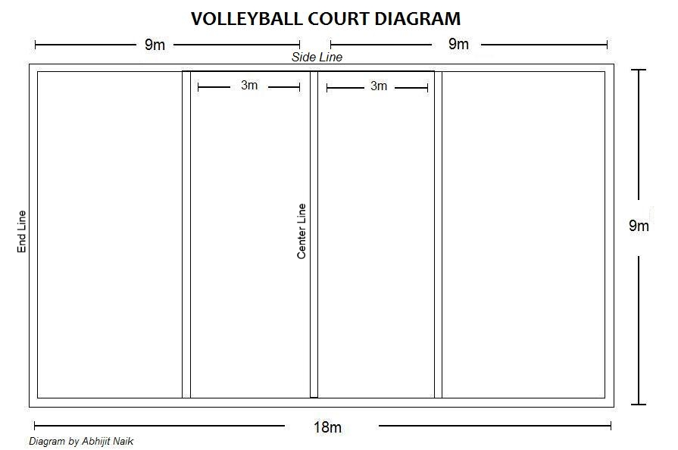
Back Row Spikes
X
X
X

Slide 14
Antenna
If the ball goes over the net OUTSIDE the antenna, it is OUT
If the ball contacts the antenna, it is ruled OUT

Slide 15
Ball Hits Ceiling
If the ball hits the ceiling and comes back down on the team who hit the ball's side, they may play it (as long as it is still within their allotted number of hits)
If the ball hits the ceiling and lands on the opponent's side, it is a point for the receiving team
If the ball gets stuck in the ceiling, it is a replay

Slide 16
Other Court Interference
Play stops IMMEDIATELY when a ball from another court crosses any court boundary line
A replay of that point will occur

Slide 17
Volleyball Referees
2 referees per court
One "UP" referee
One "DOWN" referee

Slide 18
Up Referee Responsibilities
Signal and blow whistle for service
Point to team that is awarded point and tell why:
In bounds hit
Out of bounds hit
Touched and hit out of bounds
4 Hits
Watching In/Out on all 4 lines

Slide 19
Up Referee Signals
Ready for service
Ball lands in
Ball lands out
Ball touched and lands out
Redo
4 Hits

Slide 20
Down Referee Responsibilities
Calls in/out of bounds on their boundary line
Watches for antenna hits
Watches for players stepping over the center line
(Keep score)

Slide 21
Scorecards
Make sure you record the proper scores to the proper teams!
A player from the winning team must initial/sign by the score after each game for verification!
Circle the winning team name
Put your employee ID number on the bottom of each scorecard for all games you referee

Slide 22
Sportsmanship
Write sportsmanship rating on scorecard after match for both teams
If you eject any player, they must leave (can’t stay around to watch)

Slide 23
Sub Reporting Policy
If you have a sub work your shift, YOU are responsible for reporting who is subbing for you.
Fill out the form online
If you do not fill out the sub form and neither of you show up, YOU will be held accountable for missing the shift

Slide 24
Play During a Work Shift
You must email Nathan if you are scheduled to play during a work shift
You do not get paid to play

Slide 25
Your Participation in IMs
We encourage you to participate in our program!
But there will be zero tolerance for poor sportsmanship from you or your team

Slide 26
Intramurals or Cell Phone
If you are found to be using your cell phone during a game, you will be asked to leave your shift for the night and will be grounds for immediate termination
Checking your phone between games is fine as long as it does not interfere with checking in players etc.

Slide 27
3 Strike Policy
Any combination of 3 disciplinary offenses will result in termination of employment
However, any single offense could ultimately lead to your dismissal

