Slide 1
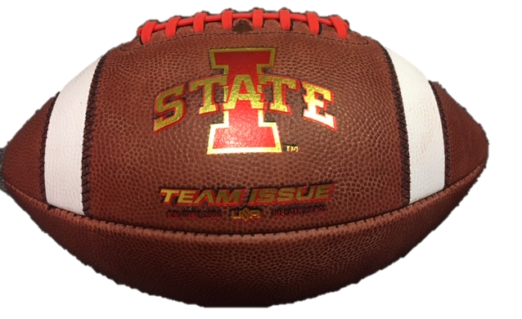
Iowa State University Intramural Flag Football Referee Training Information

Slide 2
Flag Football Rules Overview
Starting the Game
EVEN or ODD to determine who starts with the ball/field direction
Team winning the “toss” has option to choose to defer, receive, kick, or choose direction
The opposing team then has the option starting the second half
If a team “chooses” to kick (dumb), it is still the opposite team’s choice to pick a direction for that half AND still get the first choice in the 2nd half (could get the ball to start both halves)
Deferring: this means they want the first choice in the 2nd half. The opposing team will choose what they want to do in the first half.

Slide 3
Flag Football Rules Overview
Player Equipment
No jewelry is allowed that is deemed dangerous (hoop earrings, necklaces, bracelets, etc)
Shoes must be worn
No metal spikes/cleats
No sandals
No steel toed boots
Tennis shoes and molded cleat shoes are legal
No shorts/pants with belt loops, pockets, draw string exposed
It is recommended, but not required, that players wear mouth/tooth protectors (mouth guard)

Slide 4
Flag Football Rules Overview
Game Length
2 – 20 minute halves
Each team has 1 timeout per half (do NOT carry over)
Continuous clock until the last 2 minutes of the 2nd half
Clock stops in the last 2 minutes:
Run out of bounds
Incomplete pass
Touchdown (conversion NOT timed)
Penalty administration
First downs (clock starts on ready for play whistle)

Slide 5
Flag Football Rules Overview
Overtime Rules
Each team will start 1st and goal from the 10 yard line
Captain who didn’t call toss at beginning of game calls this toss
Options to play offense/defense first OR which end of field to play
Each team is guaranteed a possession on offense unless a defensive team intercepts the ball and returns it for a touchdown (they win the game)

Slide 6
Flag Football Rules Overview
Common Penalties
5 Yard Penalties:
Encroachment (offsides)
False Start
Illegal Forward Pass (loss of down)
Intentional Grounding (loss of down)
10 Yard Penalties:
Illegal Blocking
Illegal Defensive Contact
Flag Guarding
Defensive Pass Interference (Automatic 1st down)
Offensive Pass Interference
Roughing the Passer (Automatic 1st down)
Throw your flag as close as you can to the spot where the penalty took place.

Slide 7
Flag Football Rules Overview
Flag Football Field
ENDZONE
ENDZONE
G
20
40
20
G

Slide 8
Flag Football Rules Overview
Flag Football Field
No Kickoffs, Start at the 10 yard line
10
ENDZONE
ENDZONE
G
20
40
20
G

Slide 9
Flag Football Rules Overview
Flag Football Field
Teams gain a first down by crossing a “zone line to gain”
1st to the 20
ENDZONE
1st to the 40
ENDZONE
1st to the 20
1st & Goal
G
20
40
20
G

Slide 10
Flag Football Rules Overview
Flag Football Field
PAT attempts from 3 or 10 yard line
3
2
ENDZONE
ENDZONE
G
20
40
20
G

Slide 11
Flag Football Rules Overview
Flag Football Field
Is it a 1st down or not?
ENDZONE
ENDZONE
G
20
40
20
G

Slide 12
Flag Football Rules Overview
Flag Football Field
NO – if penalty is accepted you replay the down and the line to gain is still the 40
Still the line to gain
ENDZONE
ENDZONE
G
20
40
20
G

Slide 13
B
Areas
U
L2
L1
R

Slide 14
Referee Mechanics
Before Snap:
Set cones for line of scrimmages 2 yards apart
Tell in a loud voice the down and yard line to gain
“2nd down quarter line to gain”
Then blow your “ready for play” whistle

Slide 15
Flag Football Rules Overview
Line of Scrimmage – Spot the Ball

Slide 16
Referee Positioning
Positioning
You should be looking at the Quarterback’s face when he is throwing (not his back)
Start 7 yards deep and 7 yards to the side
B
U
L2
L1
7 yards
7 yards
R

Slide 17
Referee Keys
Stay wide and deep to avoid becoming part of the play
Primary responsibility is the QB
When pass is thrown, do NOT watch the ball; keep your eyes on the passer until there is no foul threat
Help rule on illegal contact by rushers/blockers
Rule on all legal or illegal forward passes

Slide 18
Referee Positioning
B
U
L2
L1
R

Slide 19
Umpire Positioning
B
U
L2
L1
R

Slide 20
Umpire Responsibilities
Blow whistle IMMEDIATELY if a false start or offsides
Hold ground in middle of field
Looking at lineman for charging/illegal blocking
After the end of the play, help put the ball at the spot where the play ended

Slide 21
Linejudge Positioning
B
U
L2
L1
R

Slide 22
Linejudge Responsibilities
Blow whistle IMMEDIATELY if a false start or offsides
On snap, slide downfield 5 yards
Initially looking at lineman for immediate charging/illegal blocking
Then shift focus to receivers downfield as you drift
Call passes complete or incomplete
Spot the ball where the runner’s progress ended

Slide 23
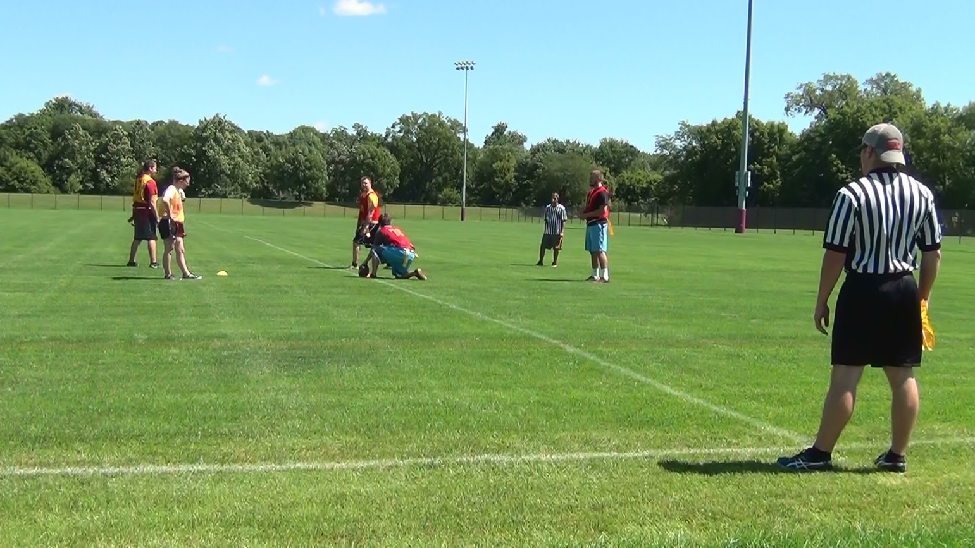
Flag Football Rules Overview
Line Judge Mechanics/Positions
Offense behind orange cone, Defense behind yellow cone
Each sideline ref is responsible for a team
One has offense, other has defense

Slide 24
Flag Football Rules Overview
Line of Scrimmage
Neither team may jump across their line of scrimmage line at any time. Players can NOT jump back onside. This is a penalty!

Slide 25
Backjudge Positioning
B
L2
L1
R

Slide 26
Backjudge Responsibilities
NO ONE gets behind you!
Watch receivers for pass interference
Help spot the ball when in your area

Slide 27
Flag Football Rules Overview
Offsides

Slide 28
Flag Football Rules Overview
False Starts

Slide 29
Flag Football Rules Overview
Spotting the Ball

Slide 30
Flag Football Rules Overview
Snapping the Ball
Direct snaps are NOT allowed.

Slide 31
Flag Football Rules Overview
Snapping the Ball
The player receiving the snap must be at least 2 yards behind the line of scrimmage.

Slide 32
Flag Football Rules Overview
Snapping the Ball
The player receiving the snap must be at least 2 yards behind the line of scrimmage.

Slide 33
Flag Football Rules Overview
Screen Blocking
The defender must avoid contacting the blocker in any way
The blocker may NOT initiate contact by moving into the defender
Blockers may move to gain position

Slide 34
Flag Football Rules Overview
Legal Screen Blocking

Slide 35
Flag Football Rules Overview
Illegal Defensive Contact
Swim Move

Slide 36
Flag Football Rules Overview
Illegal Defensive Contact
Bull Rush

Slide 37
Flag Football Rules Overview
Illegal Offensive Contact

Slide 38
Flag Football Rules Overview
Illegal Offensive Contact

Slide 39
Flag Football Rules Overview
Illegal Offensive Contact

Slide 40
Flag Football Rules Overview
Illegal Offensive Contact

Slide 41
Flag Football Rules Overview
Eligible Receivers
ALL players on the field are eligible receivers
The passer may NOT catch his/her own untouched pass (can catch a deflected pass)
Only one (1) foot or body part is required to be in bounds for it to be a completed pass.
If any part of that first body part touches the out of bounds line, it is incomplete.

Slide 42
Flag Football Rules Overview
Forward Passes
Only ONE forward pass is permitted per down.
The passer must be behind the line of scrimmage and not have already crossed the line of scrimmage.
You can backward pass/lateral as many times as you’d like.

Slide 43
Flag Football Rules Overview
Illegal Forward Pass

Slide 44
Flag Football Rules Overview
Legal Forward Pass

Slide 45
Flag Football Rules Overview
Fumbles
Ball is dead ANYTIME the ball touches the ground

Slide 46
Flag Football Rules Overview
Fumbles
Ball is dead ANYTIME the ball touches the ground

Slide 47
Flag Football Rules Overview
Fumbles
Ball is dead ANYTIME the ball touches the ground

Slide 48
Flag Football Rules Overview
Flag Guarding
Players can NOT use their hands, arms, or ball to block the defender from grabbing their flag belt

Slide 49
Flag Football Rules Overview
Flag Guarding
Players can NOT use their hands, arms, or ball to block the defender from grabbing their flag belt

Slide 50
Flag Football Rules Overview
Flag Guarding
Players can NOT use their hands, arms, or ball to block the defender from grabbing their flag belt

Slide 51
Flag Football Rules Overview
Legal Running Form

Slide 52
Flag Football Rules Overview
No Stripping/Striking at Ball

Slide 53
Flag Football Rules Overview
Roughing the Passer

Slide 54
Flag Football Rules Overview
Flags fall off before pulled
One hand touch above the waist

Slide 55
Flag Football Rules Overview
Push out of bounds is ILLEGAL

Slide 56
Flag Football Rules Overview
No Diving Allowed by the Ball Carrier
If a player PURPOSEFULLY dives, the ball is spotted at the spot where the player left their feet

Slide 57
Flag Football Rules Overview
Punting
On 4th down, the referee will ask the offensive captain if the team wants to try for the first down (go for it) or punt.
The decision will be announced to the defense and will give them ample time to align themselves.
On the Punt:
Kicking team must remain behind the line of scrimmage until the ball is kicked.
Receiving team may not cross their line of scrimmage until the ball is kicked
You may only return the ball if it is caught in the air. If the ball touches the ground, the ball is dead at that spot and will be where the offensive team will begin.

Slide 58
Positioning on Punts
B
U
L1
L2
R

Slide 59
Flag Football Rules Overview
Punting

Slide 60
Flag Football Rules Overview
Punting – Spot Pass
A pass is allowed on a punt return by the player who catches the kick
When the player catches the punt, they have the option to throw the ball or they can also then decide to run with it as well.
That player can only throw a pass if they don’t run with the ball first
If the pass is incomplete, the ball will be placed at the spot where the pass was attempted.

Slide 61
Flag Football Rules Overview
Punting – Spot Pass

Slide 62
Flag Football Rules Overview
Avoid This!

Slide 63
Flag Football Rules Overview
Mercy Rule
If a team is ahead by 19 or more points at or inside the 2:00 mark of the 2nd half, the game will be called.

Slide 64
Penalty Enforcements
Assess most penalties from either the SPOT of the foul OR at the end of the run (play) – whichever hurts the offending team more!
5 Yard Penalties:
Offsides: penalized from the line of scrimmage
False Start: penalized from the line of scrimmage
5 Yard Penalties AND Loss of Down:
Illegal Forward Pass: penalized from the SPOT of the foul
Intentional Grounding: penalized from the SPOT of the foul (where QB threw the ball)
10 Yard Penalties:
Flag Guarding: penalized from the SPOT of the foul UNLESS the runner is downs behind the penalty (then you penalize from the end of the run).
Illegal Offensive Blocking: penalized from the SPOT of the foul
Illegal Defensive Contact: penalized from end of the run
Pass Interference (offense or defense): Penalized from the Line of Scrimmage
Roughing the Passer: penalized from end of the run (Automatic 1st Down)
Strike or attempt to steal ball: penalized from end of the run
Charging by the Runner: penalized from the SPOT of the foul
Unnecessary Roughness of any kind: penalize from end of run

Slide 65
Arriving/Checking In
Games @ MWL Fields
Parking……NOT in MWL lot
Only in the Lied lot
Arrive ON TIME
Bring your whistle!
Check in with the supervisor(s)
Check in at the hut on the northwest side of the fields
Know your IM ID number
Supervisor will assign you your field
Grab equipment for field if necessary
ALL referees will wear a referee shirt

Slide 66
Payroll - Workday
Via mobile phone App
Via ipad on site
Sign in tonight to ensure process works
If unable to do either of these, make sure the supervisors put a note next to your name regarding payroll
Make sure you sign out when you leave!
If you forget to clock out, you need to email me!
End of each week/payroll cycle, you will need to submit hours worked via Workday.

Slide 67
Checking In Players
Participants MUST have some form of photo ID
ISU ID card preferred
Driver’s license OK
No ID = NO PLAY
PRINT names (FULL names) LEGIBLY on scorecard

Slide 68
Scorecard Items
Print your employee # on bottom of the scorecard for every game that you referee
When a team scores, have their team member go over and record it on the scoresheet
Circle the winning team and make sure the score is recorded
NEW: a player from the winning team must initial/sign by the score after each game for verification

Slide 69
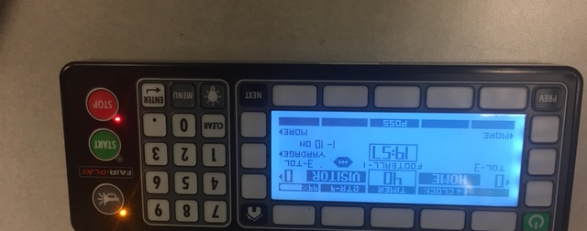
Running Scoreboards
Turn scorebox control on
You will have a remote for each field
Remote controls clock only (start/stop)
Use the scorebox to change score

Slide 70
Sub Reporting Policy
If you have a sub work your shift, YOU are responsible for reporting who is subbing for you.
Fill out the form online
If you do not fill out the sub form and neither of you show up, YOU will be held accountable for missing the shift

Slide 72
Play During a Work Shift
You must email Nathan if you are scheduled to play during a work shift
You do not get paid to play

Slide 73
Your Participation in IMs
We encourage you to participate in our program!
But there will be zero tolerance for poor sportsmanship from you or your team

Slide 74
Intramurals or Cell Phone
If you are found to be using your cell phone during a game, you will be asked to leave your shift for the night and will be grounds for immediate termination
Checking your phone during halftime or in between games is fine as long as it does not interfere with checking in players etc.

Slide 75
3 Strike Policy
Any combination of 3 disciplinary offenses will result in termination of employment
However, any single offense could ultimately lead to your dismissal

Slide 76
University Payroll
You get paid on the 15th and last day of each month
If you work between:
1-15 of a month: you get paid for that on the last day of the month
16-last day of month: you get paid for that on the 15th of the following month

Slide 77
Referee Assessment for Teams

Slide 78
Flag Football Rules Overview
Have FUN!
Have a great flag football season!

